Slide 1
Week 6: Linked List
Doubly Linked List –Part 2
WIA1002/ WIB1002/WXES1117 :
Data Structures

Slide 2
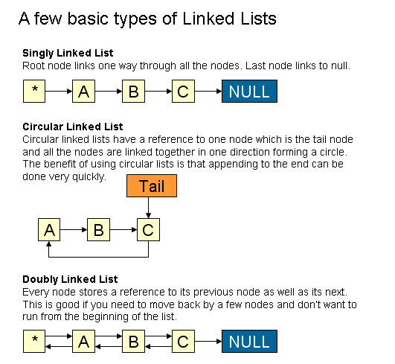
Types of Linked List-Recall

Slide 3
Doubly Linked List
A doubly-linked list (also called two-way linked list) is a linked data structure that consists of a set of sequentially linked records called nodes.
Each node contains two fields, called links, that are references to the previous and to the next node in the sequence of nodes.
The beginning and ending nodes previous and next links, respectively, point to some kind of terminator, typically a sentinel node or null, to facilitate traversal of the list.
If there is only one sentinel node, then the list is circularly linked via the sentinel node.
It can be conceptualized as two singly linked lists formed from the same data items, but in opposite sequential orders.

Slide 4
Pictorial View of Doubly Linked List
point to the next
point to the previous
The two node links allow traversal of the list in either direction. While adding or removing a node in a doubly-linked list requires changing more links than the same operations on a singly linked list, the operations are simpler and potentially more efficient, because there is no need to keep track of the previous node during traversal or no need to traverse the list to find the previous node, so that its link can be modified.

Slide 5
Disadvantages
Each node requires an extra pointer, requiring more space
The insertion or deletion of a node takes a bit longer (more pointer operations)

Slide 6
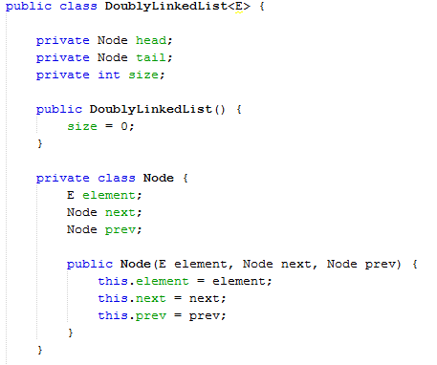
Consider the Following Doubly Linked List Class
Linked list will have head and tail
Each node consist of 2 pointers
next and prev
Attention to these
To construct new node

Slide 7
Doubly Linked List Insertion
Insertion into a doubly-linked list has three cases (same as singly linked list)
  Inserting a new node before the head
  Inserting a new node after the tail
  Inserting a new node a the middle of the list

Slide 8
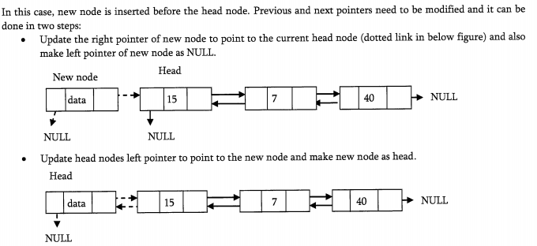
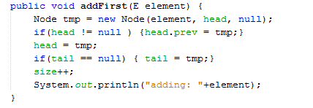
Inserting a Node at the Beginning

Slide 9
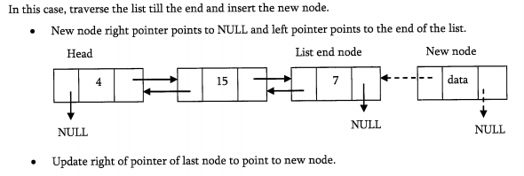
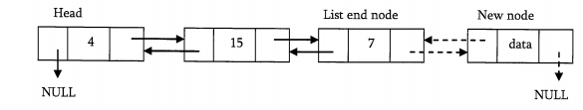
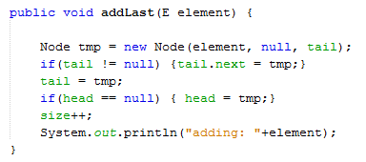
Inserting a Node at the Ending

Slide 10
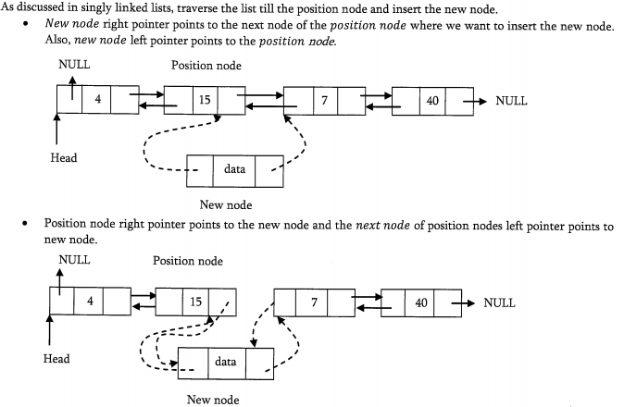
Inserting a Node at the Middle

Slide 11
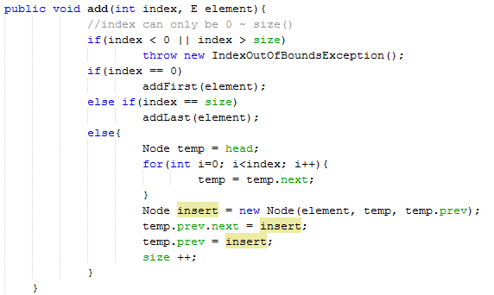
Inserting a Node at the Middle

Slide 12
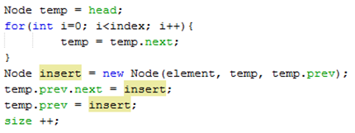

//traverse & stop at requested index (in below case stop at index=2) if we
want to add element add index =2
temp.prev
temp
temp.prev= previous node before inserted index, if insert index 2, than temp.prev =node at index 1
(temp.prev).next = next variable
of the temp.prev
new Node introduced at index @ 2

Slide 13
//traverse & stop at requested index (in below case stop at index=2) if we
want to add element add index =2
temp.prev
temp
(temp.prev).next
new Node introduced at index @ 2

Slide 14
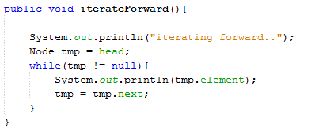
Traversing Forward
Similar with Singly Linked List

Slide 15
Traversing Backward
Try to code!

Slide 16
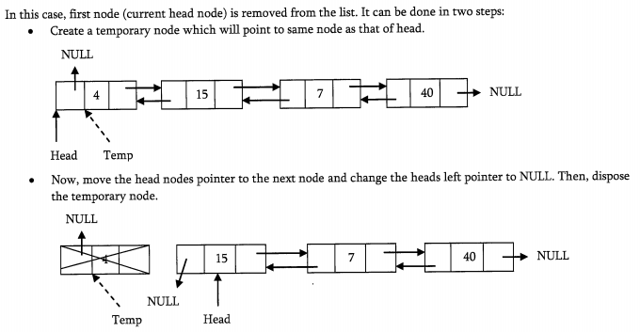
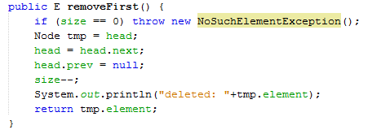
Deleting the First Node

Slide 17
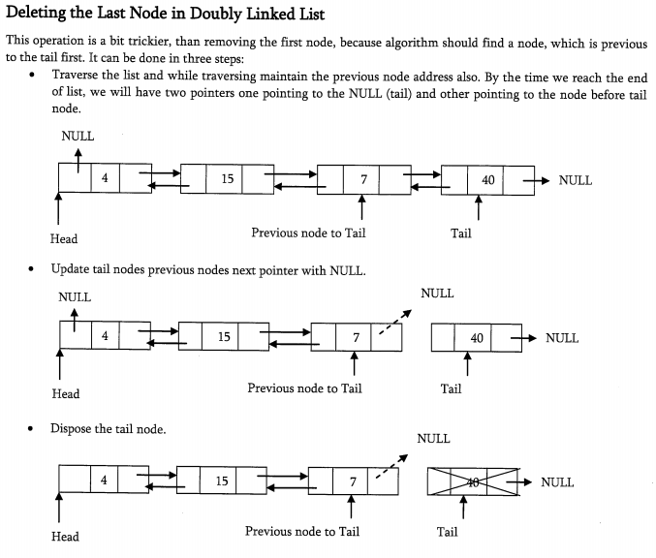
Deleting the Last Node

Slide 18
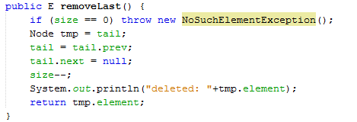
Deleting the Last Node

Slide 19
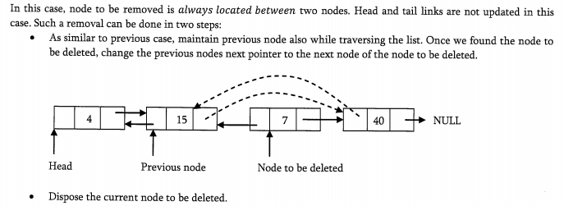
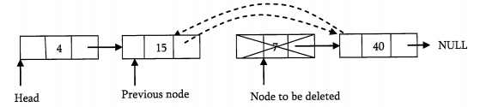
Deleting an Intermediate Node
Try to code!

Slide 20
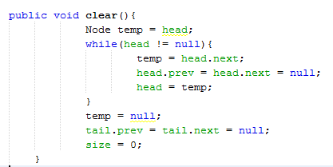
Clear All Nodes in the List

